Slide 1
Do Vascular Networks Branch Optimally or Randomly across Spatial Scales?
Elif Tekin, David Hunt, Mitchell G. Newberry, Van M. Savage
Zotero Library: 0 General and Review/Power Cost

Slide 2
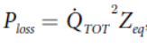
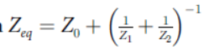
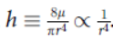
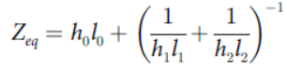
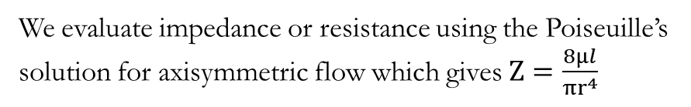
Expression for power cost
Power loss is given by the following expression
where Q˙_{TOT} is the total rate of flow and the impedance
We evaluate impedance or resistance using the Poiseuille’s solution for axisymmetric flow which gives $Z=\frac{8μl}{πr^{4}}$
Denoting , gives

Slide 4
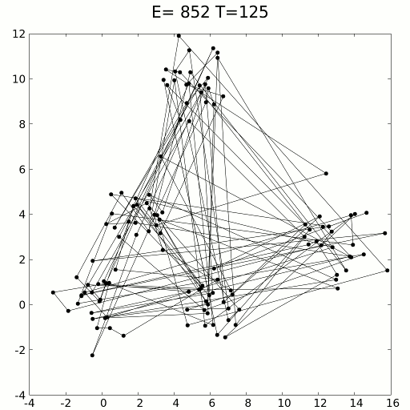

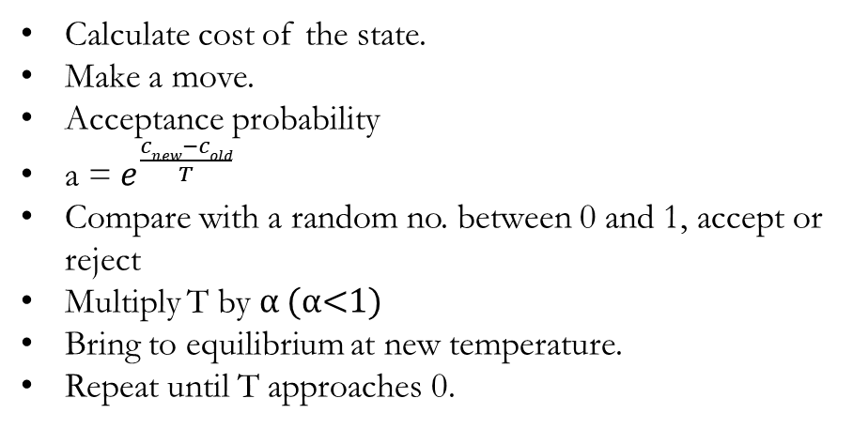
Optimization- Simulated Annealing
Calculate cost of the state.
Make a move.
Acceptance probability
a = $e^{\frac{cnew−cold}{T}}$
Compare with a random no. between 0 and 1, accept or reject
Multiply T by α (α<1)
Bring to equilibrium at new temperature.
Repeat until T approaches 0.
Source: Wikipedia

Slide 5
Design of vascular networks: A mathematical model approach
Jian Yang, and Yongtian Wang
Zotero Library: 0 General and Review

Slide 6
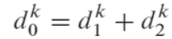
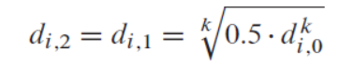
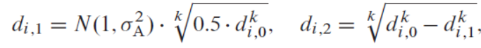
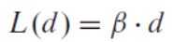
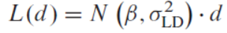
Basics
Vessel diameter
Power law relationship:
Solving for daughter diameter
Accounting for asymmetry between daughter branches
Vessel length
For a given length-to-diameter ratio, β
Using a Gaussian distribution to control variability

Slide 7
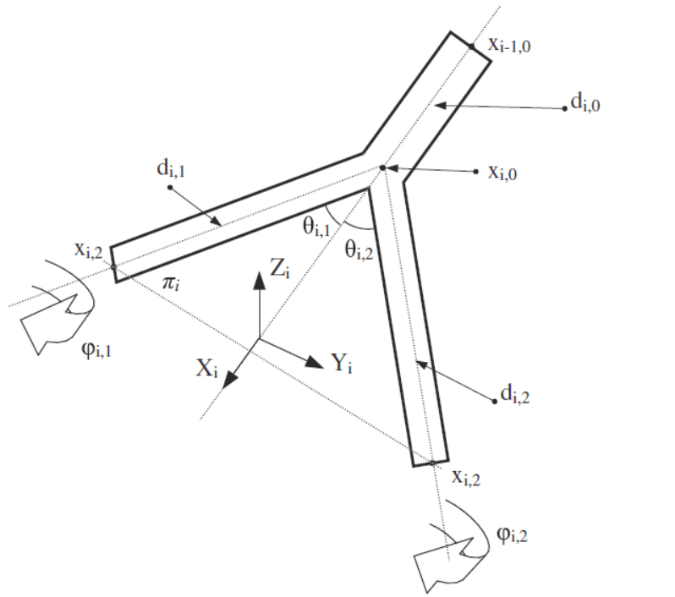
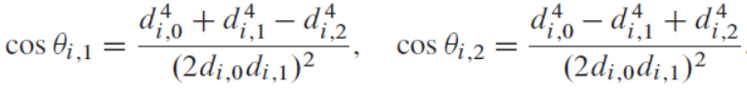
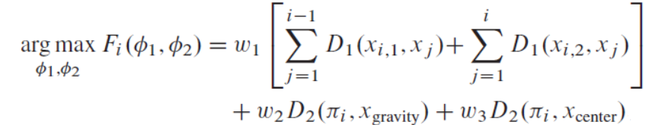
…continued
Bifurcation angle
Optimal angles in the plane (minimizing total volume)
Finding ϕ
where D1 (x1,x2) is the Euclidian distance between point x1 and x2. D2(π, x) is the absolute distance between plane π and point x. xgravity and xcenter are defined as the locations of gravity point and centripetal point, respectively. w1, w2, and w3 are weighting factors. Because the first term in the above equation is the summary of the current segment to the rest of the vascular structures, the second and the third terms are multiplied by the number of the existing vessel segments. The centripetal force is relative to the diameter or length of the vessel segment. Hence, the ratio of the weighted factor w1, w2, and w3 are taken as 1: (2i–1) : (2i–1).L(d).

Slide 8
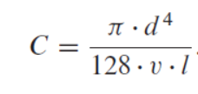
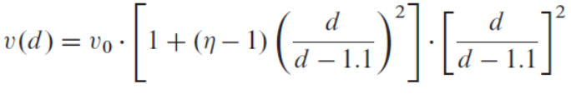
Hemodynamic Calculations
Assumption:
Axisymmetric, laminar flow in straight, circular cylinders
Conductance from Poiseuille’s law :
Assuming constant systemic hematocrit = 0.5
Relationship between viscosity and vessel diameter based on Fahraeus–Lindqvist effect
where η is given by
and ν0 = 9 x10⁻⁶ mmHg . s

Slide 9
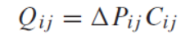
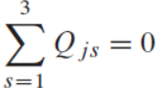
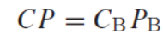
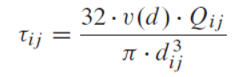
…continued
The volumetric flow Q_{ij} in a vessel segment between two successive node points i and j is given in terms of the pressure differential P_{ij} = P_{i} - P_{j} and vessel cconductance C_{ij} by
Applying mass conservation gives
The terminal pressure of the feeding branch is assumed equal to the input pressure of the exiting branches. Then, if Pinflow and Pterminal are defined as constants, a set of linear algebraic term equations with nodal pressures as unknowns can be obtained as below
where C is an n x n matrix of conductance, P is an n x 1 vector with unknown pressures, and CBPB is an n x 1 vector of the conductance multiplied by the boundary pressure (root and terminals), respectively.
Wall shear stress τ_{ij} is given by

Slide 10
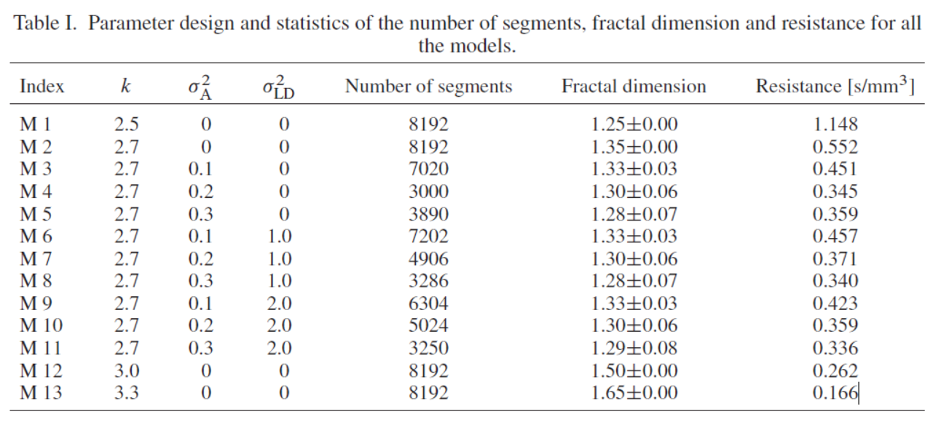
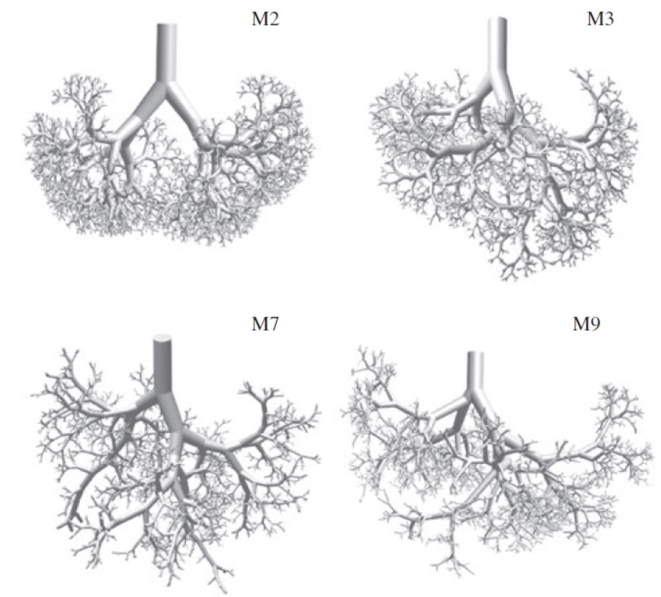
Results

Slide 11
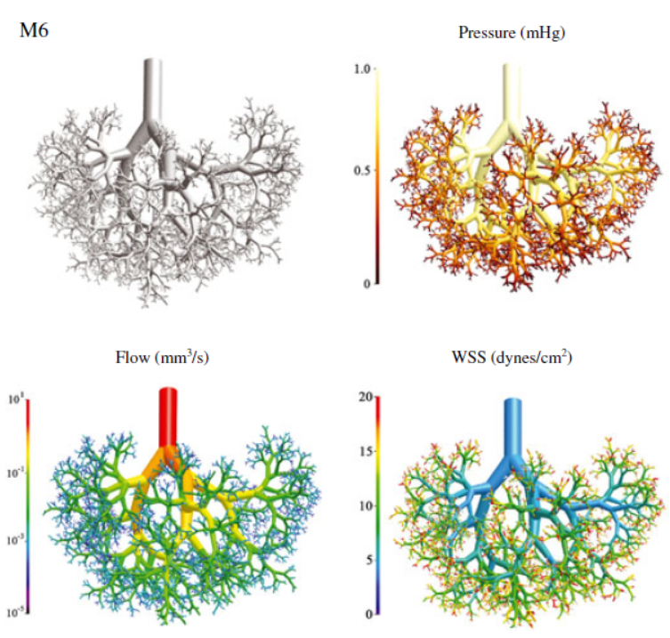
Hemodynamic Properties

Slide 12
Three-dimensional reconstruction of a vascular network by dynamic tracking of magnetite nanoparticles
Nina Olamaei, Farida Cheriet, Sylvain Deschênes, Azadeh Sharafi, and Sylvain Martel

Slide 13
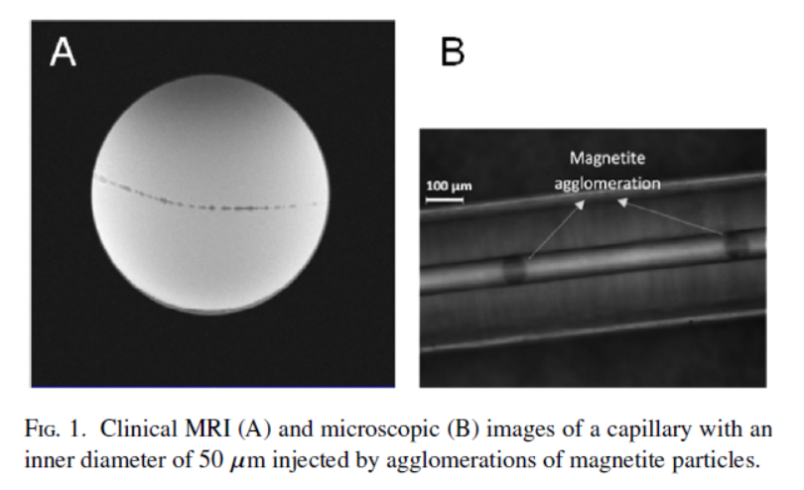
Magnetic volumes distort the B0 field of a clinical MRI scanner in a much larger scale than their actual size. It was shown that the disruption of the magnetic field caused by a magnetic particle saturated in B0 could be detected from a distance of as far as 70 times its own diameter. This disturbance appears in the form of a signal void in MR images reflecting the presence and the location of the magnetic particle.

Slide 14
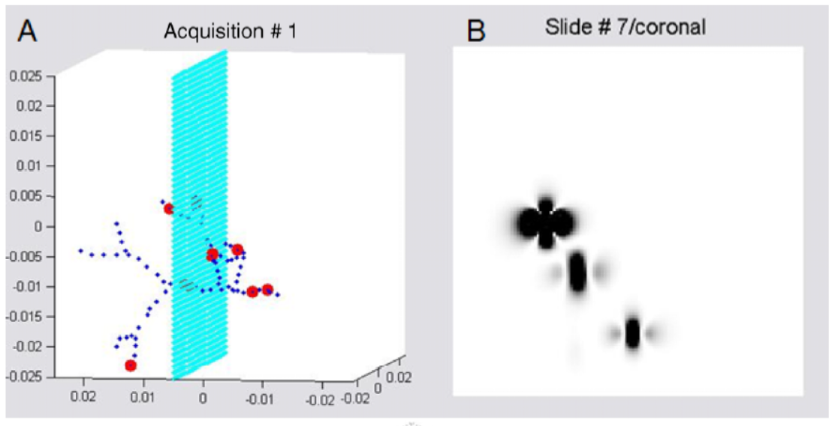
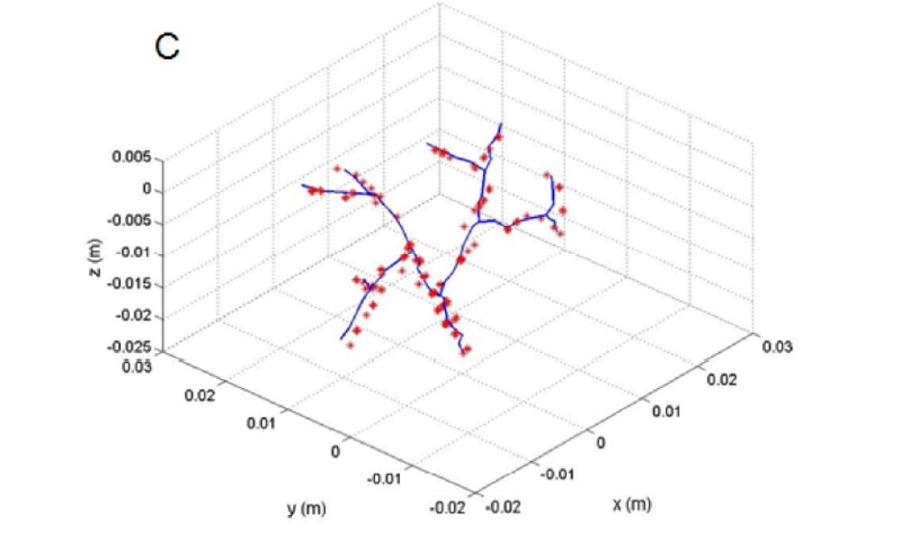

Slide 15
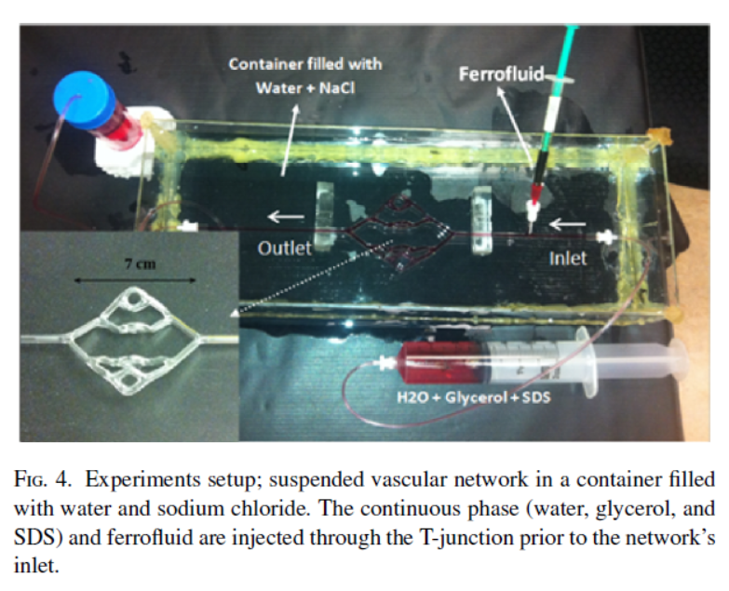

Slide 16
